Slide 1
PeerWise Cycle 2
Feedback
Verbal commentary
https://sydney.instructuremedia.com/embed/af53551e-dde3-43a7-a8b1-2c5473466ea2

Slide 2
Cycle 2
Your first taste of creative authoring
Getting intel from your peers
Their misconceptions and their insights
Example of process in the tutorial
The draft -> feedback -> review/edit cycle
But only the start really….
Introduction to the importance of collecting performance metrics
THAT will be Cycle 3

Slide 3
Question Assessment
Initial drafts must be submitted in good time
Other students have to have time to comment on them
Questions must be tagged properly
ONE tag only
Questions should be Revised
Although….
You can’t help it if others in the group don’t give you feedback in a timely manner
You can’t be expected to act on poor feedback
You are allowed to stand your ground….

Slide 4
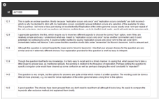
Judging Editing
All the below comments were given well before the editing phase. The author didn’t edit their question
Were the comments received:
Actionable?
Given in a timely manner?
Has the author even looked at the feedback?
No replies
Not logged in since submission!
Deliberately fuzzy ☺
Even if you you want to dismiss the feedback you get, editing at least gives the impression you have shown interest
And even misguided feedback can help your development
And even just looking at other questions helps you reflect on your own

Slide 5
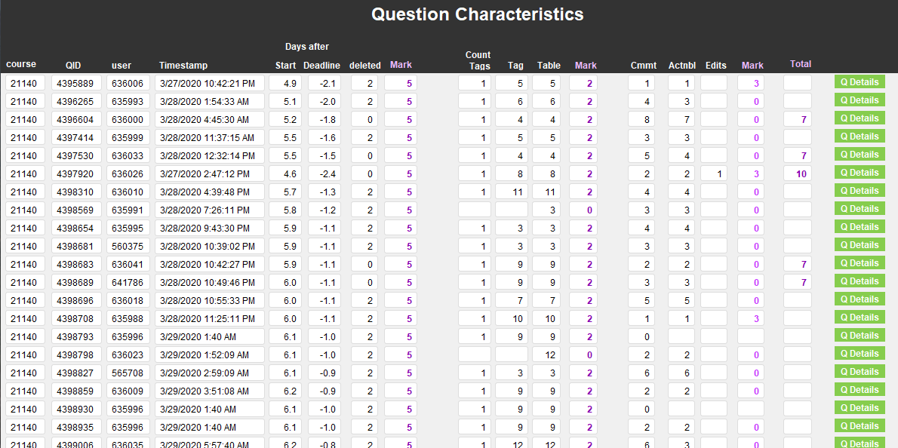
Guiding Metrics
Tagging – with check for accuracy
Timing and status information
Editing – with refection on timeliness and quality of comments

Slide 6
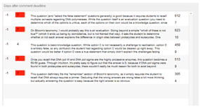
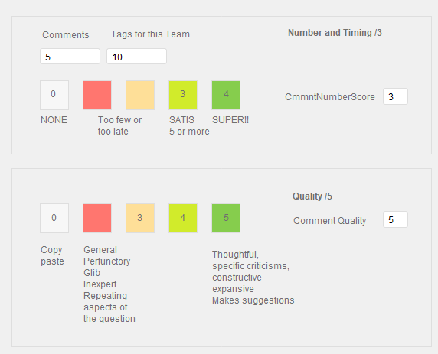
Assessing Comments
Timing, Quality and Number of comments
Comments
Must be given in a timely manner
Must be actionable
Must be on all your group members’ questions
Must NOT be the same to all!!!
You can’t help it if….
Few in your group submit questions
Your group is tardy with question submission
Your group don’t tag the questions properly
Deliberately fuzzy ☺
Number questions available for comment
(tagged correctly)

Slide 7
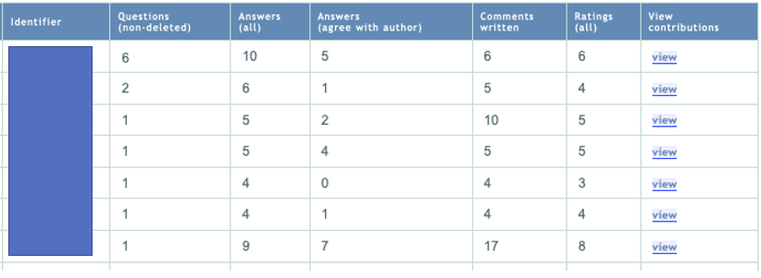
Technical Issues
Some students created new questions rather than editing
Please don’t do this…..

Slide 8
Overall Mark
In this cycle the mark was approximately equally divided between:
Question creation and revision process
Commenting: quality, quantity and timing
REMEMBER: This is all just practice…
Low stakes – just ONE little mark
Purpose is preparation for Cycles 4 and 5
Our academic judgement of YOUR question
YOUR contribution to your peers’ questions
Your response to your peers’ feedback and performance metrics
It has to be something even if sneering disrespect :-)

